Slide 1

Applicant Taster Day
DIG 5125 – Digital Media Processing
Dr Sam Smith samuel.smith@bcu.ac.uk

Slide 2
Why Digital Media Processing?
Introduce you to the principles of Digital Image and Video Processing
Fundamentals of image and video processing and manipulation
How techniques can be developed using core principles
Technical module with practical coding and theory
Digital Media Processing – Lecture 01: Introduction Dr Samuel Smith – Samuel.smith@bcu.ac.uk

Slide 3
Application Areas
We will study key principles related to:
Image manipulation
Interface/Interaction systems
Segmentation and tracking systems
Image processing systems
Weekly practical and theoretical sessions, with tutorial/lecture based theory
Digital Media Processing – Lecture 01: Introduction Dr Samuel Smith – Samuel.smith@bcu.ac.uk

Slide 4
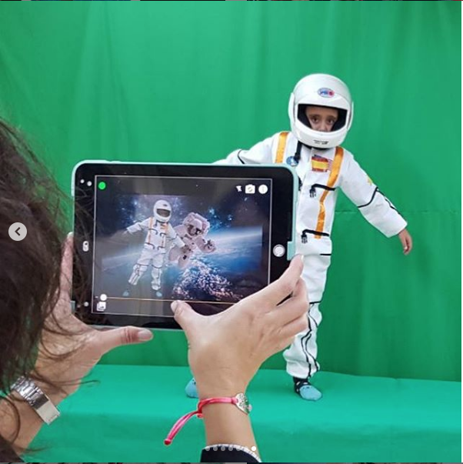
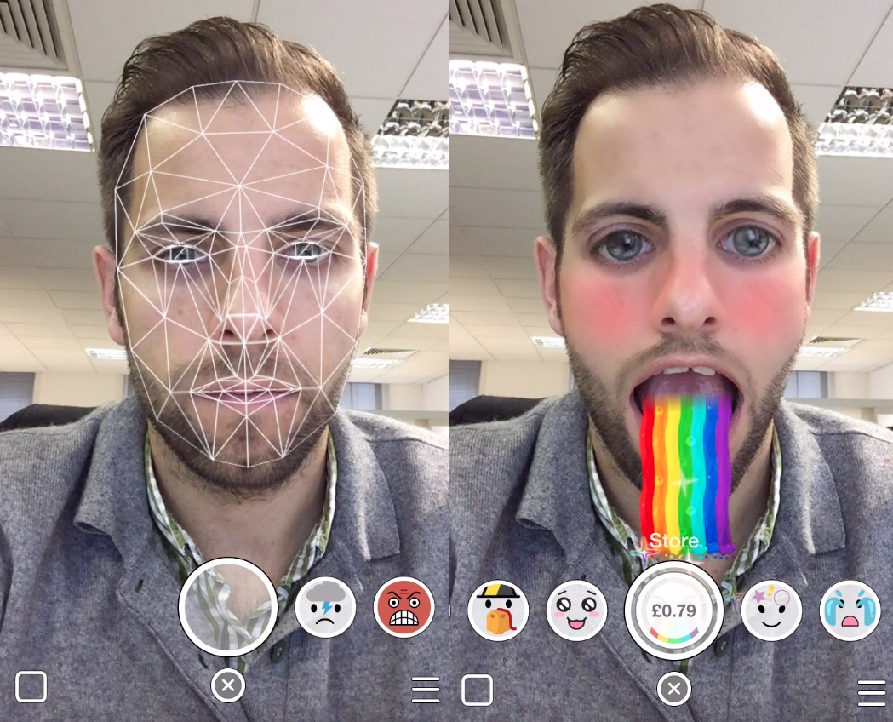
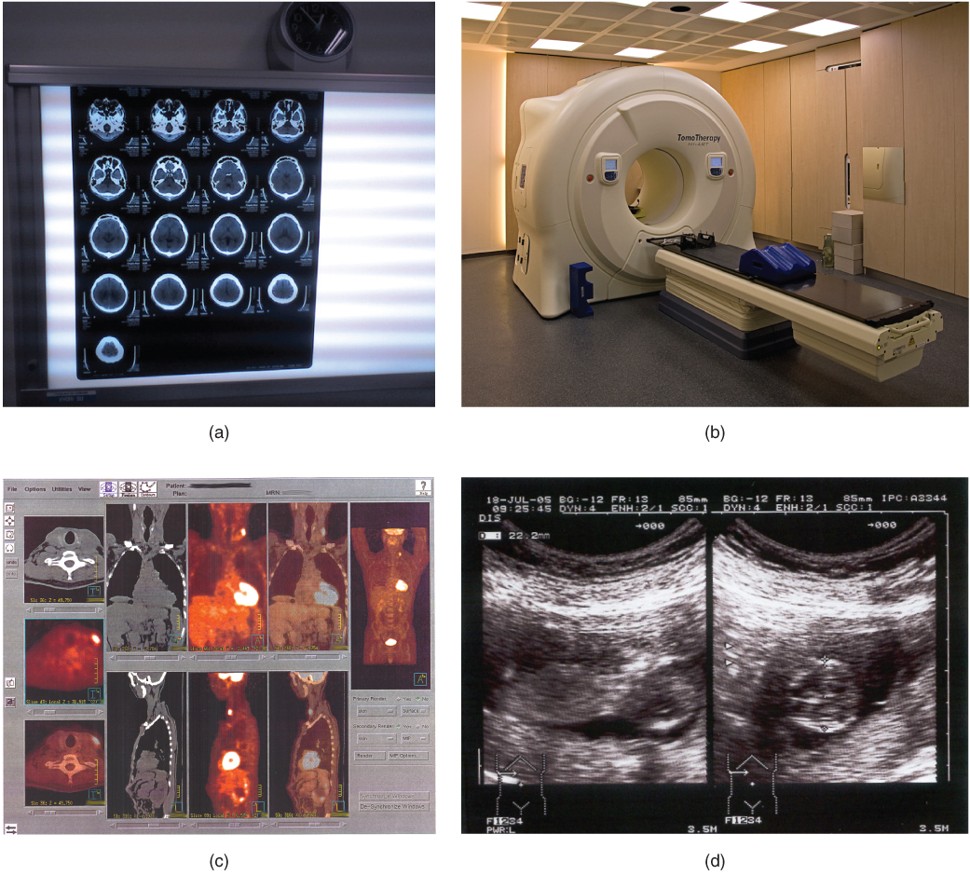
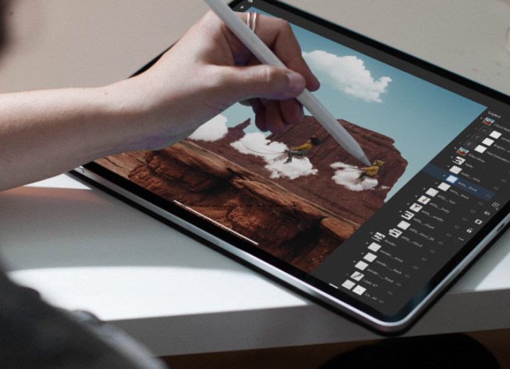
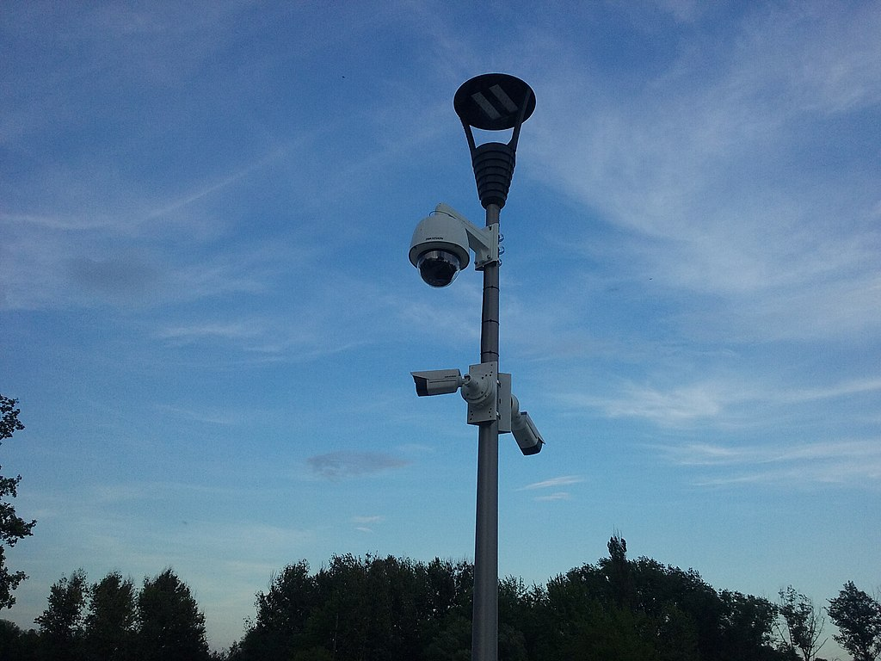
Examples
© ChromaVid
© Snapchat
© Photoshop
© Wikimedia Commons
© Wikimedia Commons – Medical Image Processing
Digital Media Processing – Lecture 01: Introduction Dr Samuel Smith – Samuel.smith@bcu.ac.uk

Slide 5
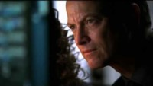
Image Processing - Movies
Digital Media Processing – Lecture 01: Introduction Dr Samuel Smith – Samuel.smith@bcu.ac.uk

Slide 6

Image Processing - Reality
Digital Media Processing – Lecture 01: Introduction Dr Samuel Smith – Samuel.smith@bcu.ac.uk

Slide 7
What is a Digital Image?
Digital Image: A numerical representation of quantised image data
Quantised: Finite representation of numeric data which is approximated to the resolution of a particular system
Digital Media Processing – Lecture 01: Introduction Dr Samuel Smith – Samuel.smith@bcu.ac.uk
Notes:
By Quantised we mean finite, basically a representation of numeric data that is approximated to the resolution of the system where they were captured or where they are displayed.

Slide 8
What is a Finite Digital?
Finite is the opposite to “infinite” meaning to be endless
Therefore Finite is defined as having a limited range
If we look closer at a digital image we will see that is made up of a limited (finite) number of pixels
Each pixel will have a value associated with it
The values associated to each pixel will be “finite” (a specific number in a defined range)
Digital Media Processing – Lecture 01: Introduction Dr Samuel Smith – Samuel.smith@bcu.ac.uk
Notes:
What we mean with finite, basically the opposite of infinite, which is endless. Finite is defined as having a limited range,

Slide 9
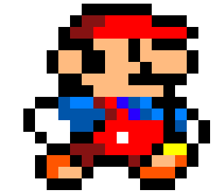
Digital Image Representation
Therefore we represent images as a two dimensional function f(x, y)
Where x and y are spatial coordinates
The amplitude of f at any pair of coordinates is called intensity or grey level
x
Note that a digital image is composed of a finite number of elements, each of which has a particular location and value – These are called pixels
y
Digital Media Processing – Lecture 01: Introduction Dr Samuel Smith – Samuel.smith@bcu.ac.uk

Slide 10
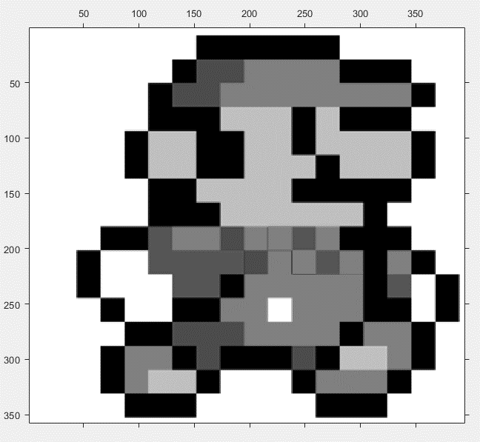
Digital Image Representation
Image = f(x,y)
Where x, y and f(x,y) are finite
X = Width (number of pixels wide)
Y = Height (number of pixels height)
f(x,y) = [0-255] Intensity value for a specific pixel
Digital Media Processing – Lecture 01: Introduction Dr Samuel Smith – Samuel.smith@bcu.ac.uk

Slide 11
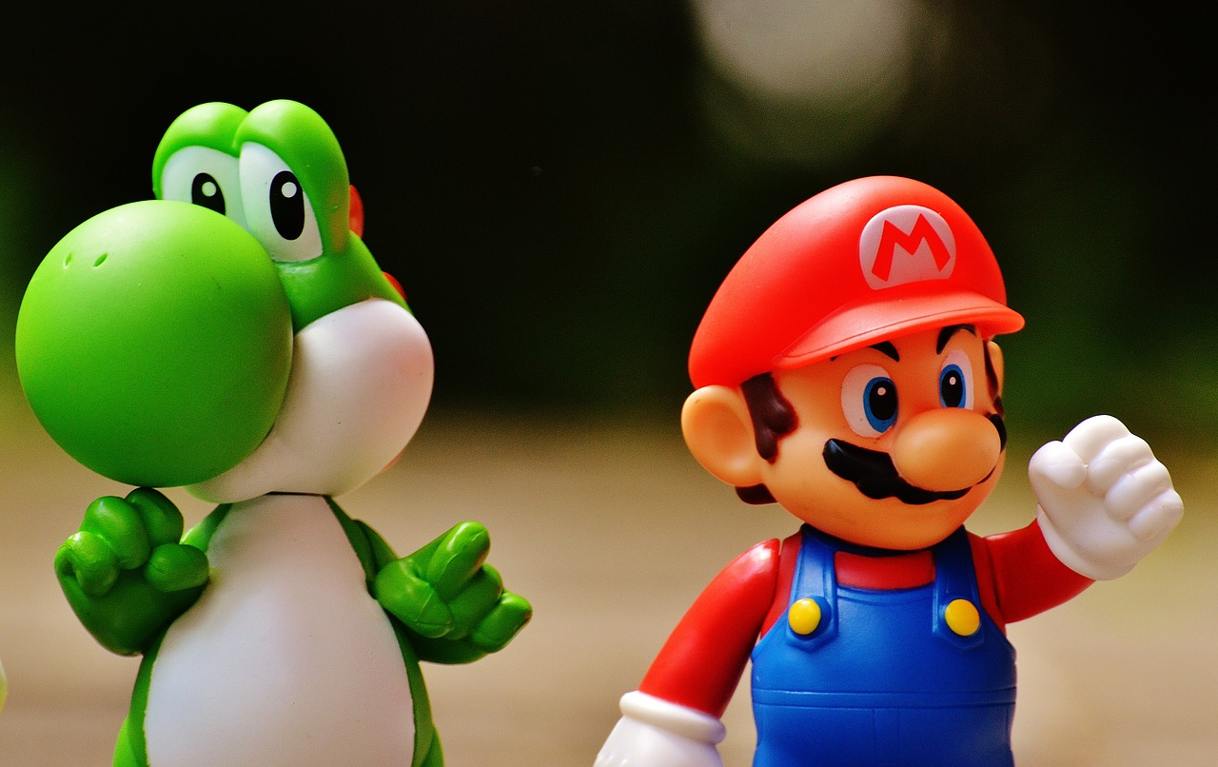
Image Types
Binary Images
Greyscale Images
RGB Images
x = 1280
x = 1280
x = 1280
y = 806
y = 806
y = 806
1 bit – 2 colours [0,1]
8 bit – 256 colours [0-255]
24 bit – 8 bit per channel [R,G,B]
0 | 1 | 1
1 | 0 | 1
0 | 0 | 0
255 | 244 | 251
243 | 211 | 123
212 | 24 | 55
255 | 244 | 251
243 | 211 | 123
212 | 24 | 55
255 | 244 | 251
243 | 211 | 123
212 | 24 | 55
255 | 244 | 251
243 | 211 | 123
212 | 24 | 55
R - red
G - green
B - blue
Digital Media Processing – Lecture 01: Introduction Dr Maite Frutos – maite.frutos@bcu.ac.uk

Slide 12
Image Processing – Zoom And Enhance in MATLAB
Import Image into software
Zoom and Crop
Upscale – Interpolation
Enhance – Sharpening filter
Digital Media Processing – Lecture 01: Introduction Dr Samuel Smith – Samuel.smith@bcu.ac.uk

Slide 13

Image Handling – Import Image
IMG = imread(‘mario.jpg’);
%Read in the image to variable I
imshow(IMG);
%show the image figure, imshow(I);
The script applies two key functions: imread and imshow
Imread takes the string argument of the local image filename and stores the image data into variable I
Digital Media Processing – Lecture 01: Introduction Dr Samuel Smith – Samuel.smith@bcu.ac.uk

Slide 14
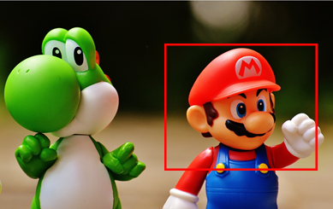
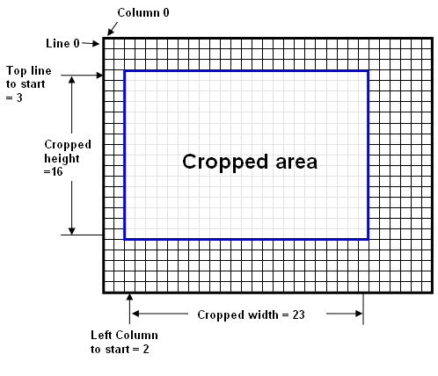
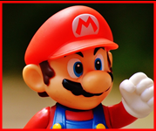
Zoom and Crop
Zooming and Cropping is a simple process
Every pixel has an index (A label that describes the pixel location)
We just select which pixels we wish to examine and discard the rest
Digital Media Processing – Lecture 01: Introduction Dr Samuel Smith – Samuel.smith@bcu.ac.uk

Slide 15
Zoom and Crop -MATLAB
figure, imshow(IMG)
% Calculate image dimensions
[r,c,z]=size(IMG);
%Define region size Px x Px
Px = 15;
% Select pixel in image
[x, y] = ginput(1);
% Calculate region around selected pixel of size Px
xdims =max(1,round(x-Px/2)):min(round(x+Px/2),c);
ydims = max(1,round(y-Px/2)):min(round(y+Px/2),r);
%Create cropped image
ZoomIMG=IMG(ydims,xdims,1:3);
Digital Media Processing – Lecture 01: Introduction Dr Samuel Smith – Samuel.smith@bcu.ac.uk

Slide 16
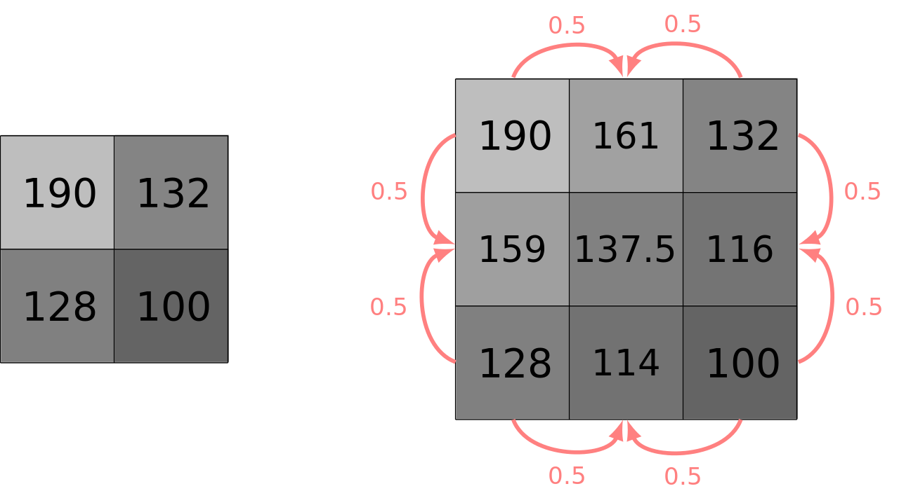
Enhance – Upscaling
We can increase pixel resolution by upscaling an image
We create new pixels and insert them between adjacent pixels with values between that of neighbouring pixels
Digital Media Processing – Lecture 01: Introduction Dr Samuel Smith – Samuel.smith@bcu.ac.uk

Slide 17

Enhance – Upscaling
% Enhance = interpolate
upscale_factor =3;
ImgEnhancedRedCh =interp2(double(ZoomIMG(:,:,1)),upscale_factor);
ImgEnhancedGreenCh =interp2(double(ZoomIMG(:,:,2)),upscale_factor);
ImgEnhancedBlueCh =interp2(double(ZoomIMG(:,:,3)),upscale_factor);
EnhancedIMG(:,:,1)=ImgEnhancedRedCh;
EnhancedIMG(:,:,2)=ImgEnhancedGreenCh;
EnhancedIMG(:,:,3)=ImgEnhancedBlueCh;
Digital Media Processing – Lecture 01: Introduction Dr Samuel Smith – Samuel.smith@bcu.ac.uk

Slide 18
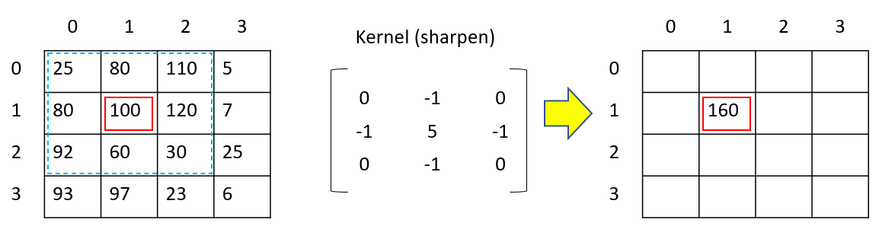
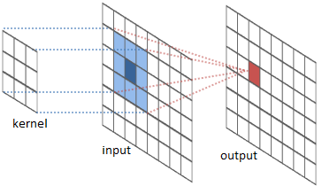
Enhance – Sharpening filter
After upscaling, the image may appear blurry
To compensate we can apply a sharpening filter
Filters use a linear process called convolution which uses addition and multiplication
There’s far too much to cover on filtering in this session
Digital Media Processing – Lecture 01: Introduction Dr Samuel Smith – Samuel.smith@bcu.ac.uk

Slide 19
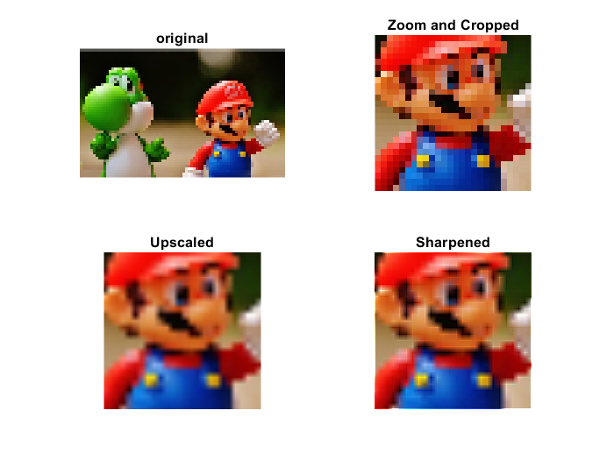
Enhance – Sharpening filter
There are several different filtering methods which we can apply
Each have different advantages and disadvantages
Today we will use the MATLAB built in filtering function
%Create sharpening filter kernel
h = [0, -1, 0; -1, 5, -1; 0, -1, 0];
% Apply filter using convolution
SharpenedIMG = imfilter(EnhancedIMG, h);
Digital Media Processing – Lecture 01: Introduction Dr Samuel Smith – Samuel.smith@bcu.ac.uk

Slide 20
Download script and test image
Download MATLAB script from https://github.com/samdsmithuk/ATD
Log into computers and launch Matlab
Digital Media Processing – Lecture 01: Introduction Dr Samuel Smith – Samuel.smith@bcu.ac.uk

